Slide 1
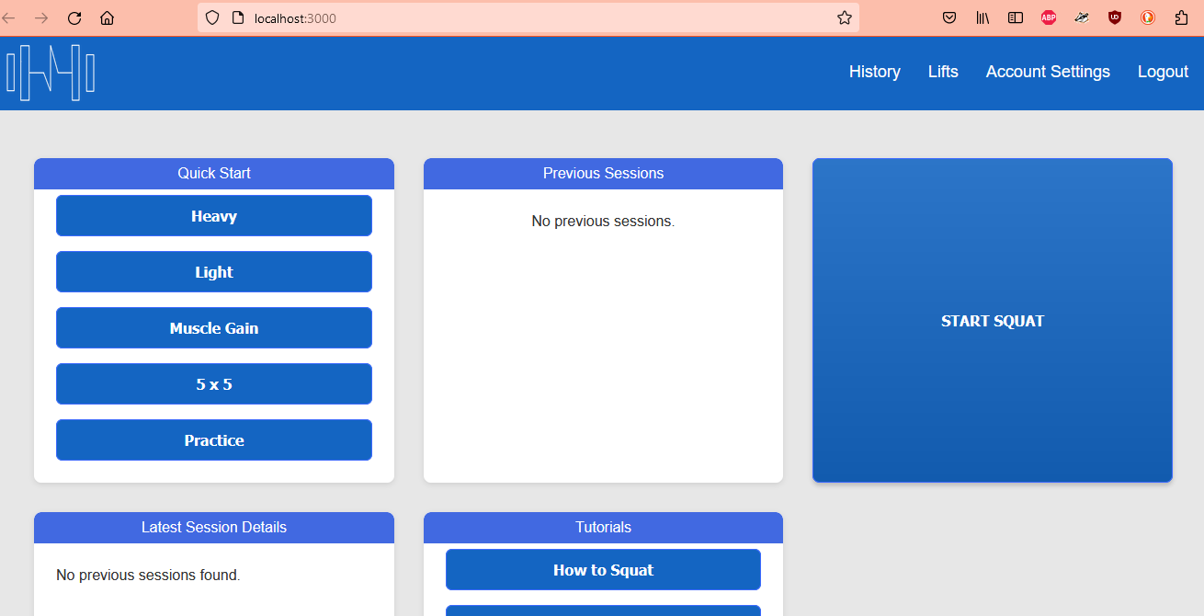
HTTPS Implementation
Website initially has no certificate.

Slide 2
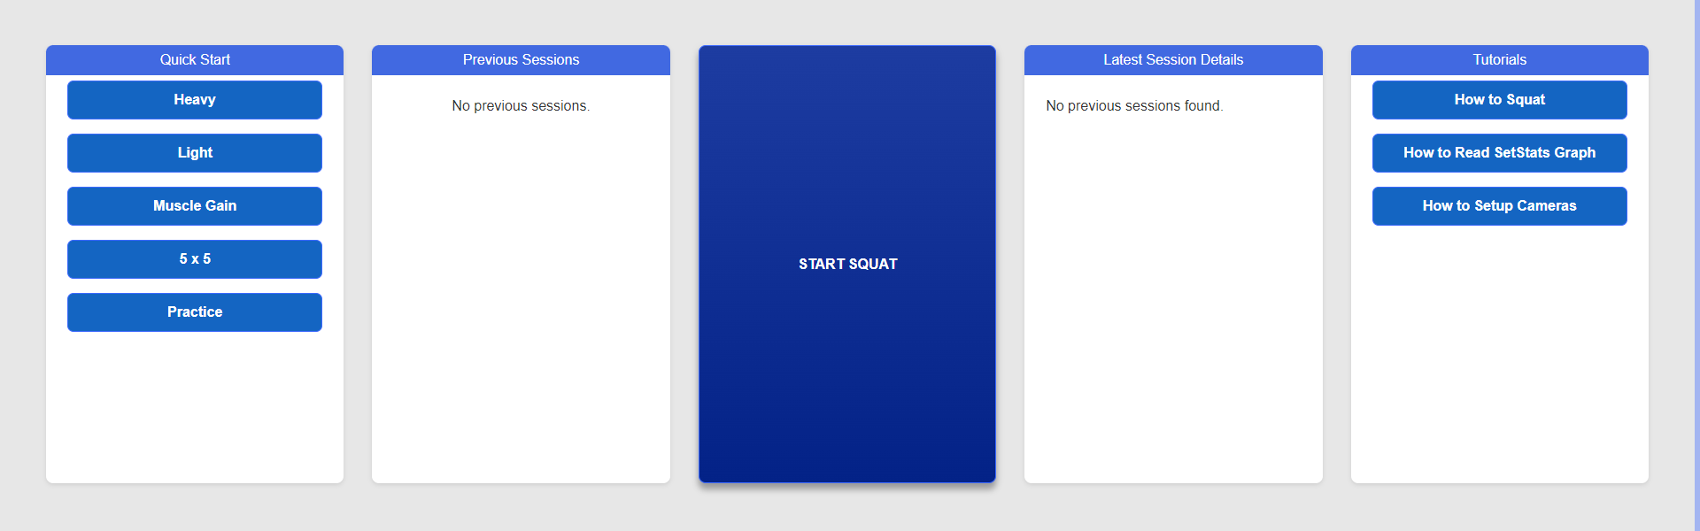
HTTPS Implementation
Full page

Slide 3
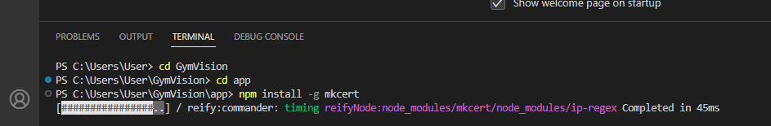
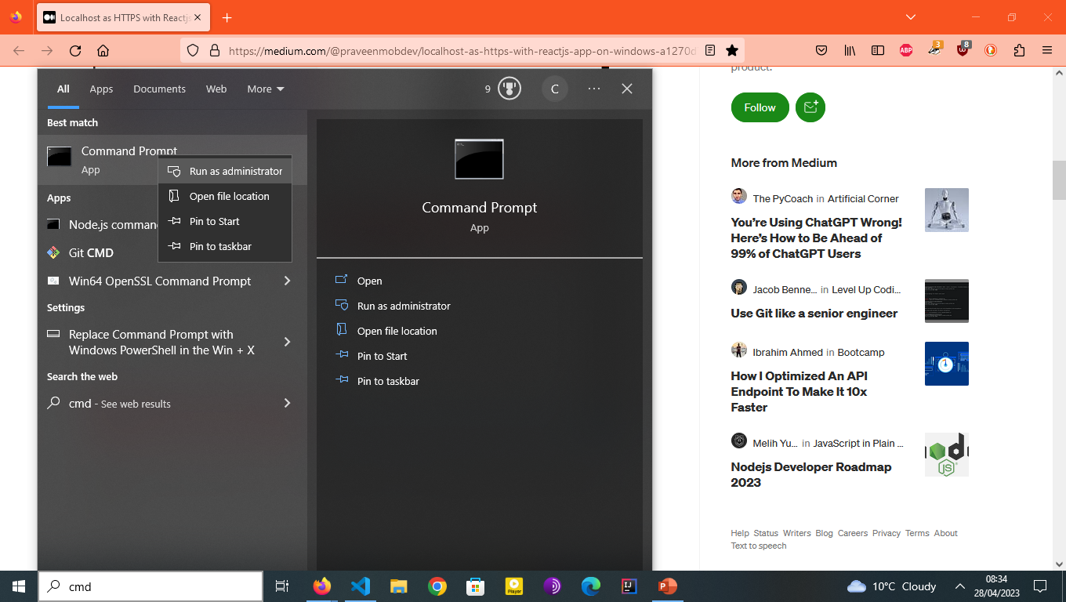
HTTPS Implementation
First enter these commands in terminal in react
Next go to cmd as admin.

Slide 4
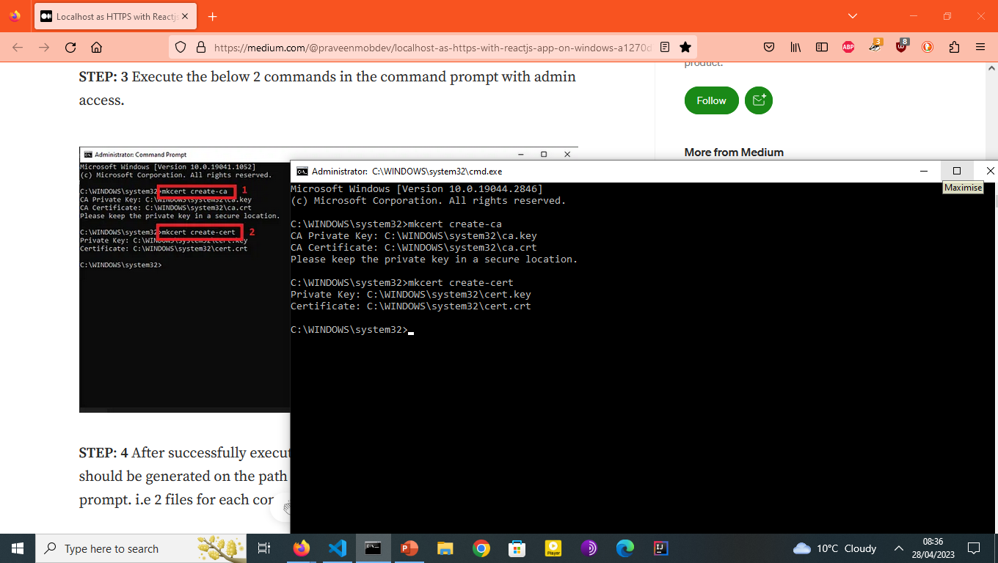
HTTPS Implementation
Next enter these commands in terminal

Slide 5
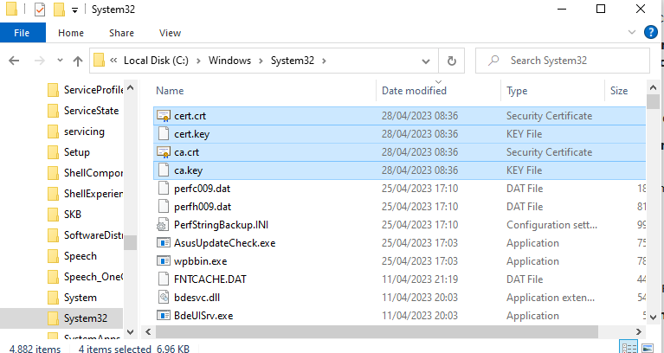
HTTPS Implementation
Next you will see these files in system32.

Slide 6
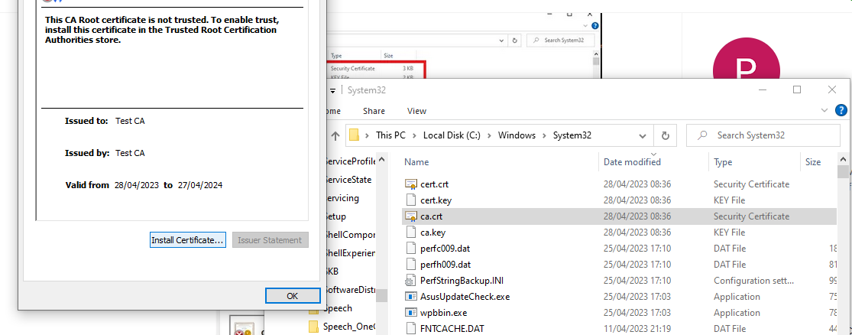
HTTPS Implementation
Then click on ca.crt file and install certificate.

Slide 7
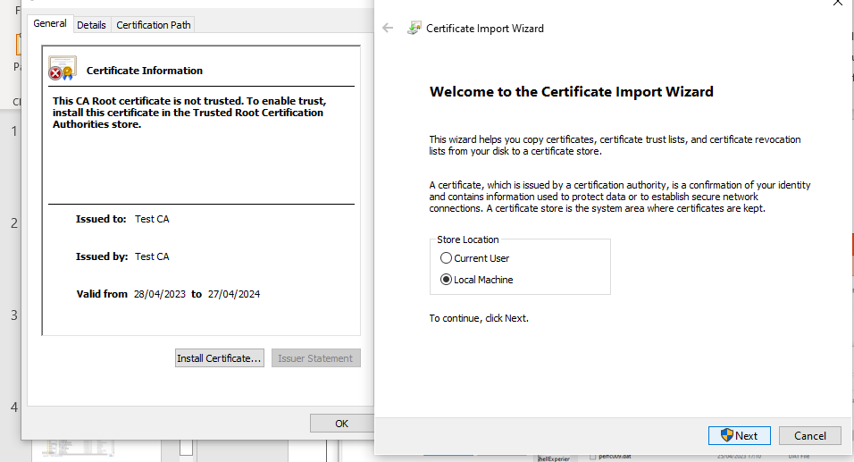
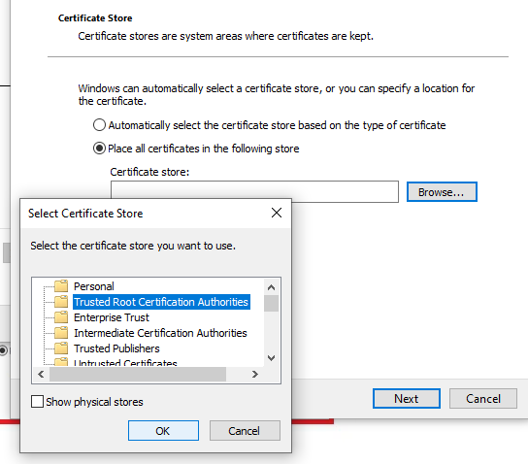
HTTPS Implementation
Click local machine then on trusted root certification authorities

Slide 8
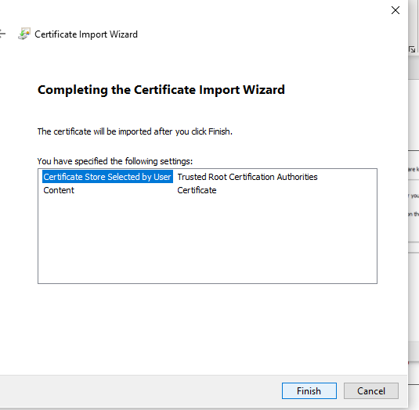
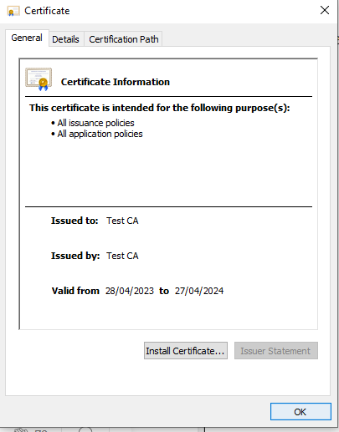
HTTPS Implementation
Click finish and you will see your certificate like this. Then click ok.

Slide 9
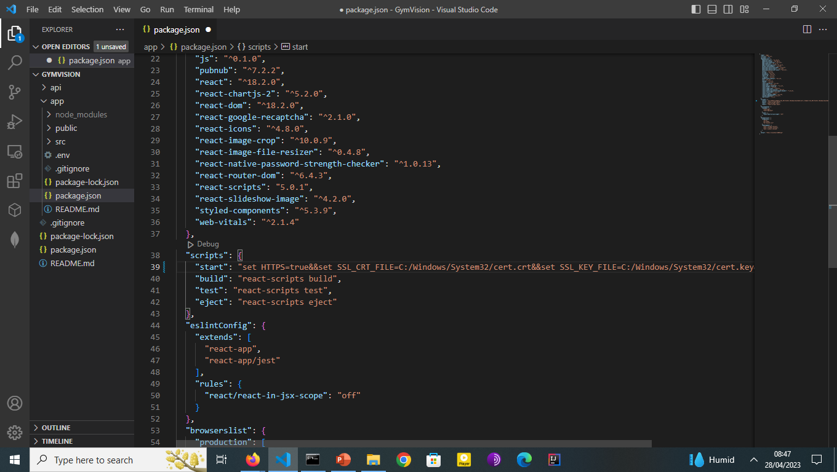
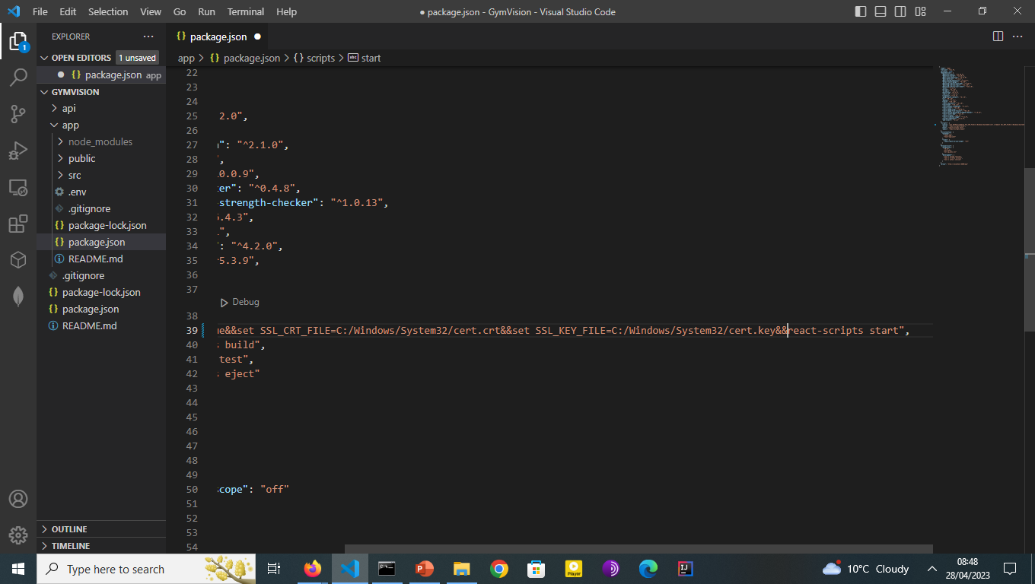
HTTPS IMPLEMENTATION
Navigate back to React Native and go to package.json file. Add the following line of code to the debug section under start.

Slide 10
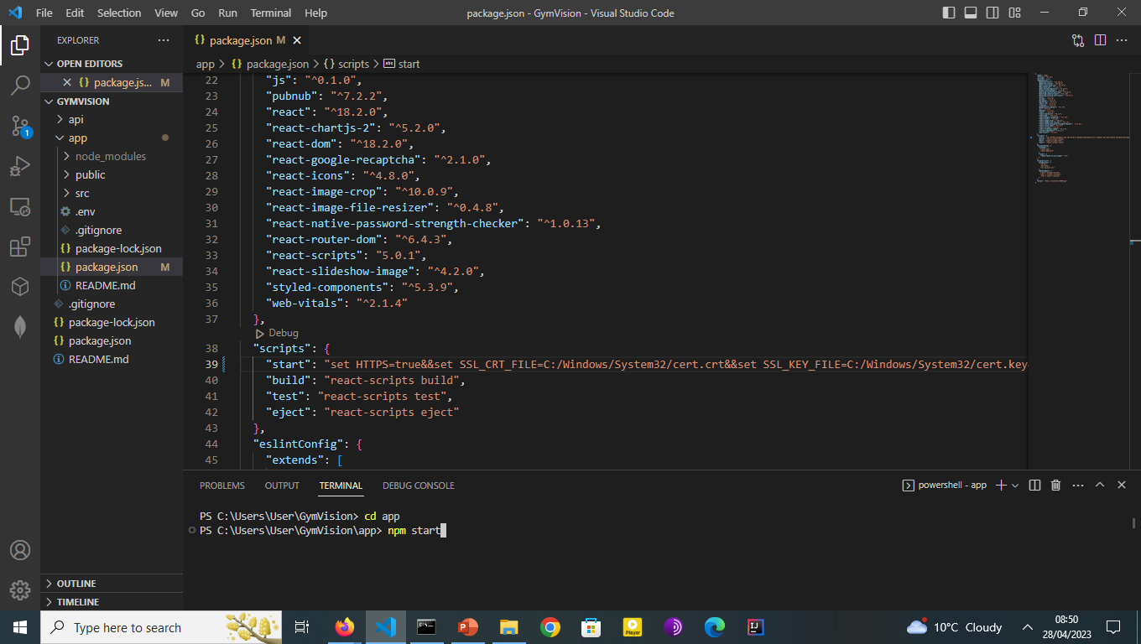
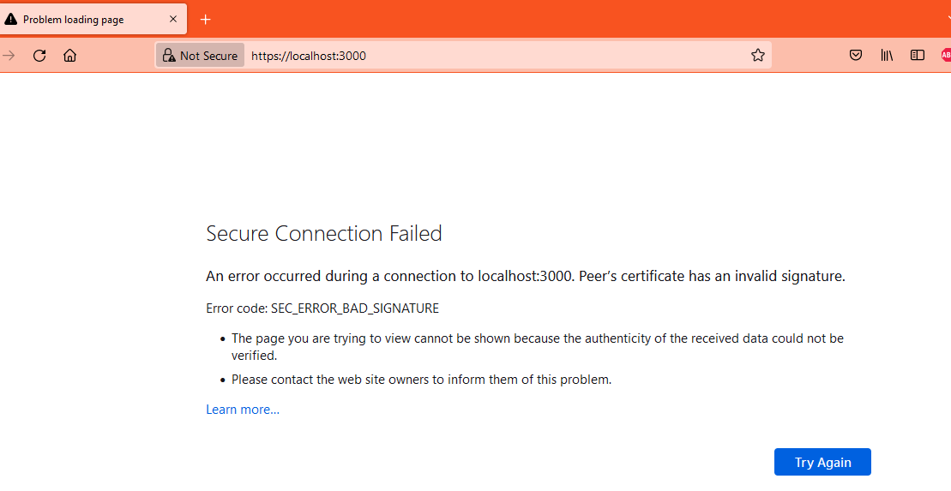
HTTPS IMPLEMENTATION
Next in react terminal start your app. You will see this screen at the start.

Slide 11
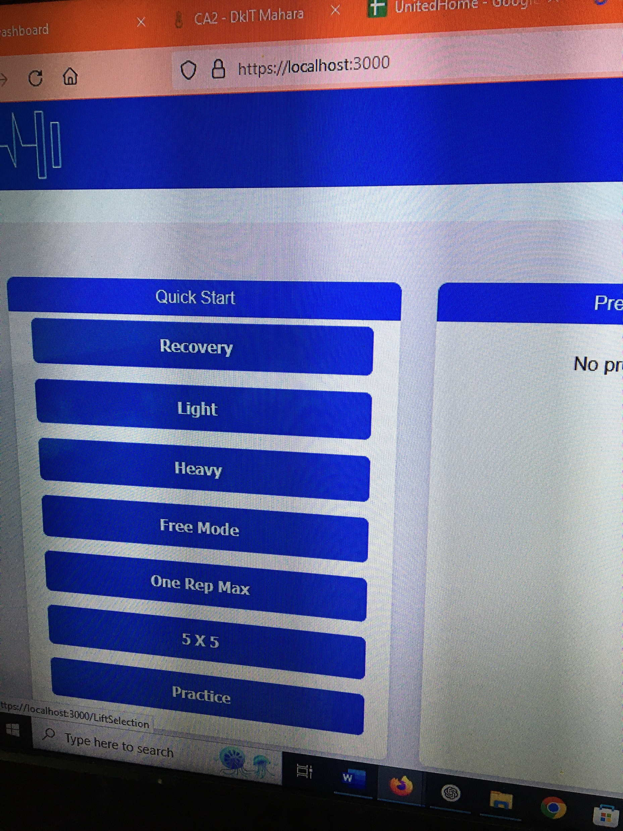
HTTPS IMPLEMENTATION
Initially it will take some time to certify the certificate. Once it is certified you will see https verified

